Slide 1
Welcome to our website !!!

Slide 2
Africa Travel

Slide 3
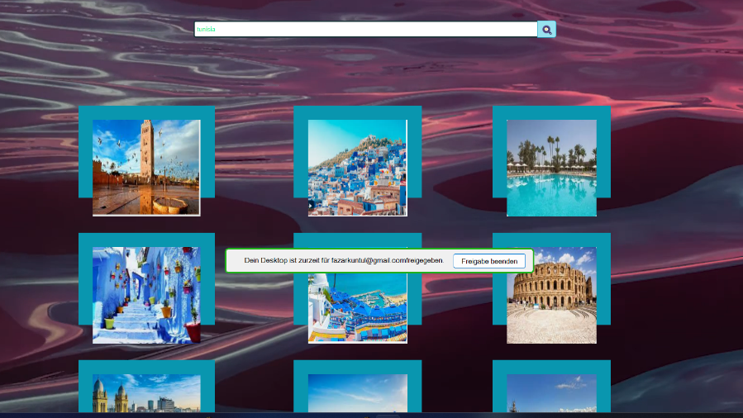

Slide 4
This is a website which assist the traveller to choose the best destination:
The website provide to traveller:
- location of countries. - its language. - some images of famous places. - description of the country and its history.

Slide 5
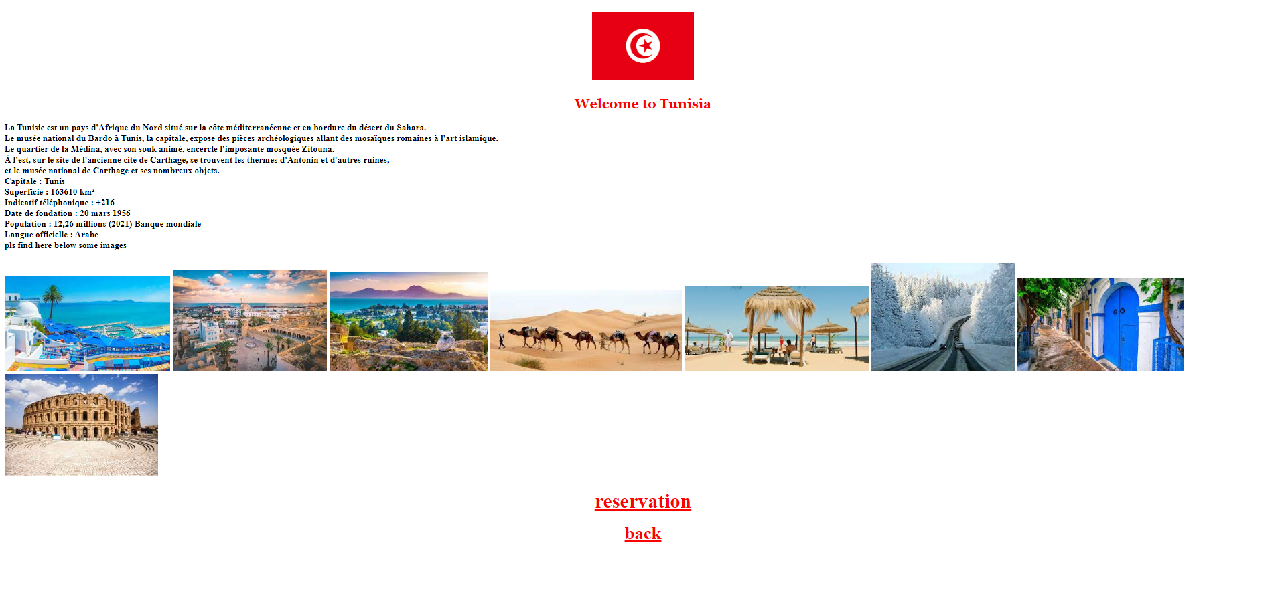

Slide 6
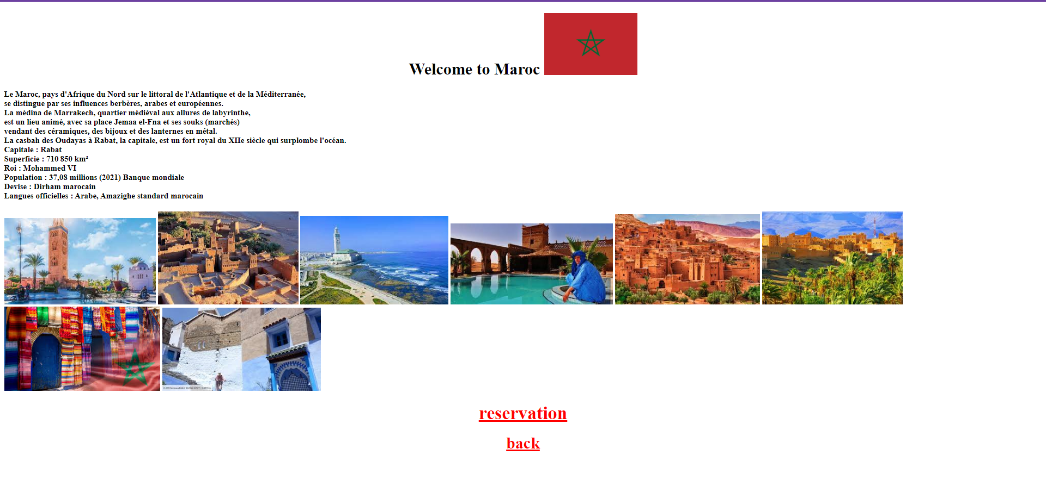

Slide 7
Conclusion
This website facilitate to the traveller to choose the right destination since he well informed about the country, its location, its language and he can also take look from the image in every county’s page. The website is easy to use it and more convenient.

Slide 8
Thank you !!!

